Slide 1
Level 4/5 – Group 6
Tom Gibbs
Fraser King
Jack Massey
Daniel Marsh

Slide 2
The Brief
2D
Tap input
Turn-based single-device multiplayer
Symmetric level design
Easy to learn game yet hard to master
Notes:
Adversarial local multiplayer
Symmertric – players have access to the same knowledge and equal opportunity regarding input effect

Slide 3
Logline and Target Audience
Logline – BEAT YOUR FOES
Target audience – XX – XX FE/MALE
Platform – Mobile

Slide 4
4 Keys to Fun
Hard
Easy
Serious
People

Slide 5
Game Concept
What the player does
Mechanics
Development of mechanics/learning curve – learn, practice, master

Slide 6
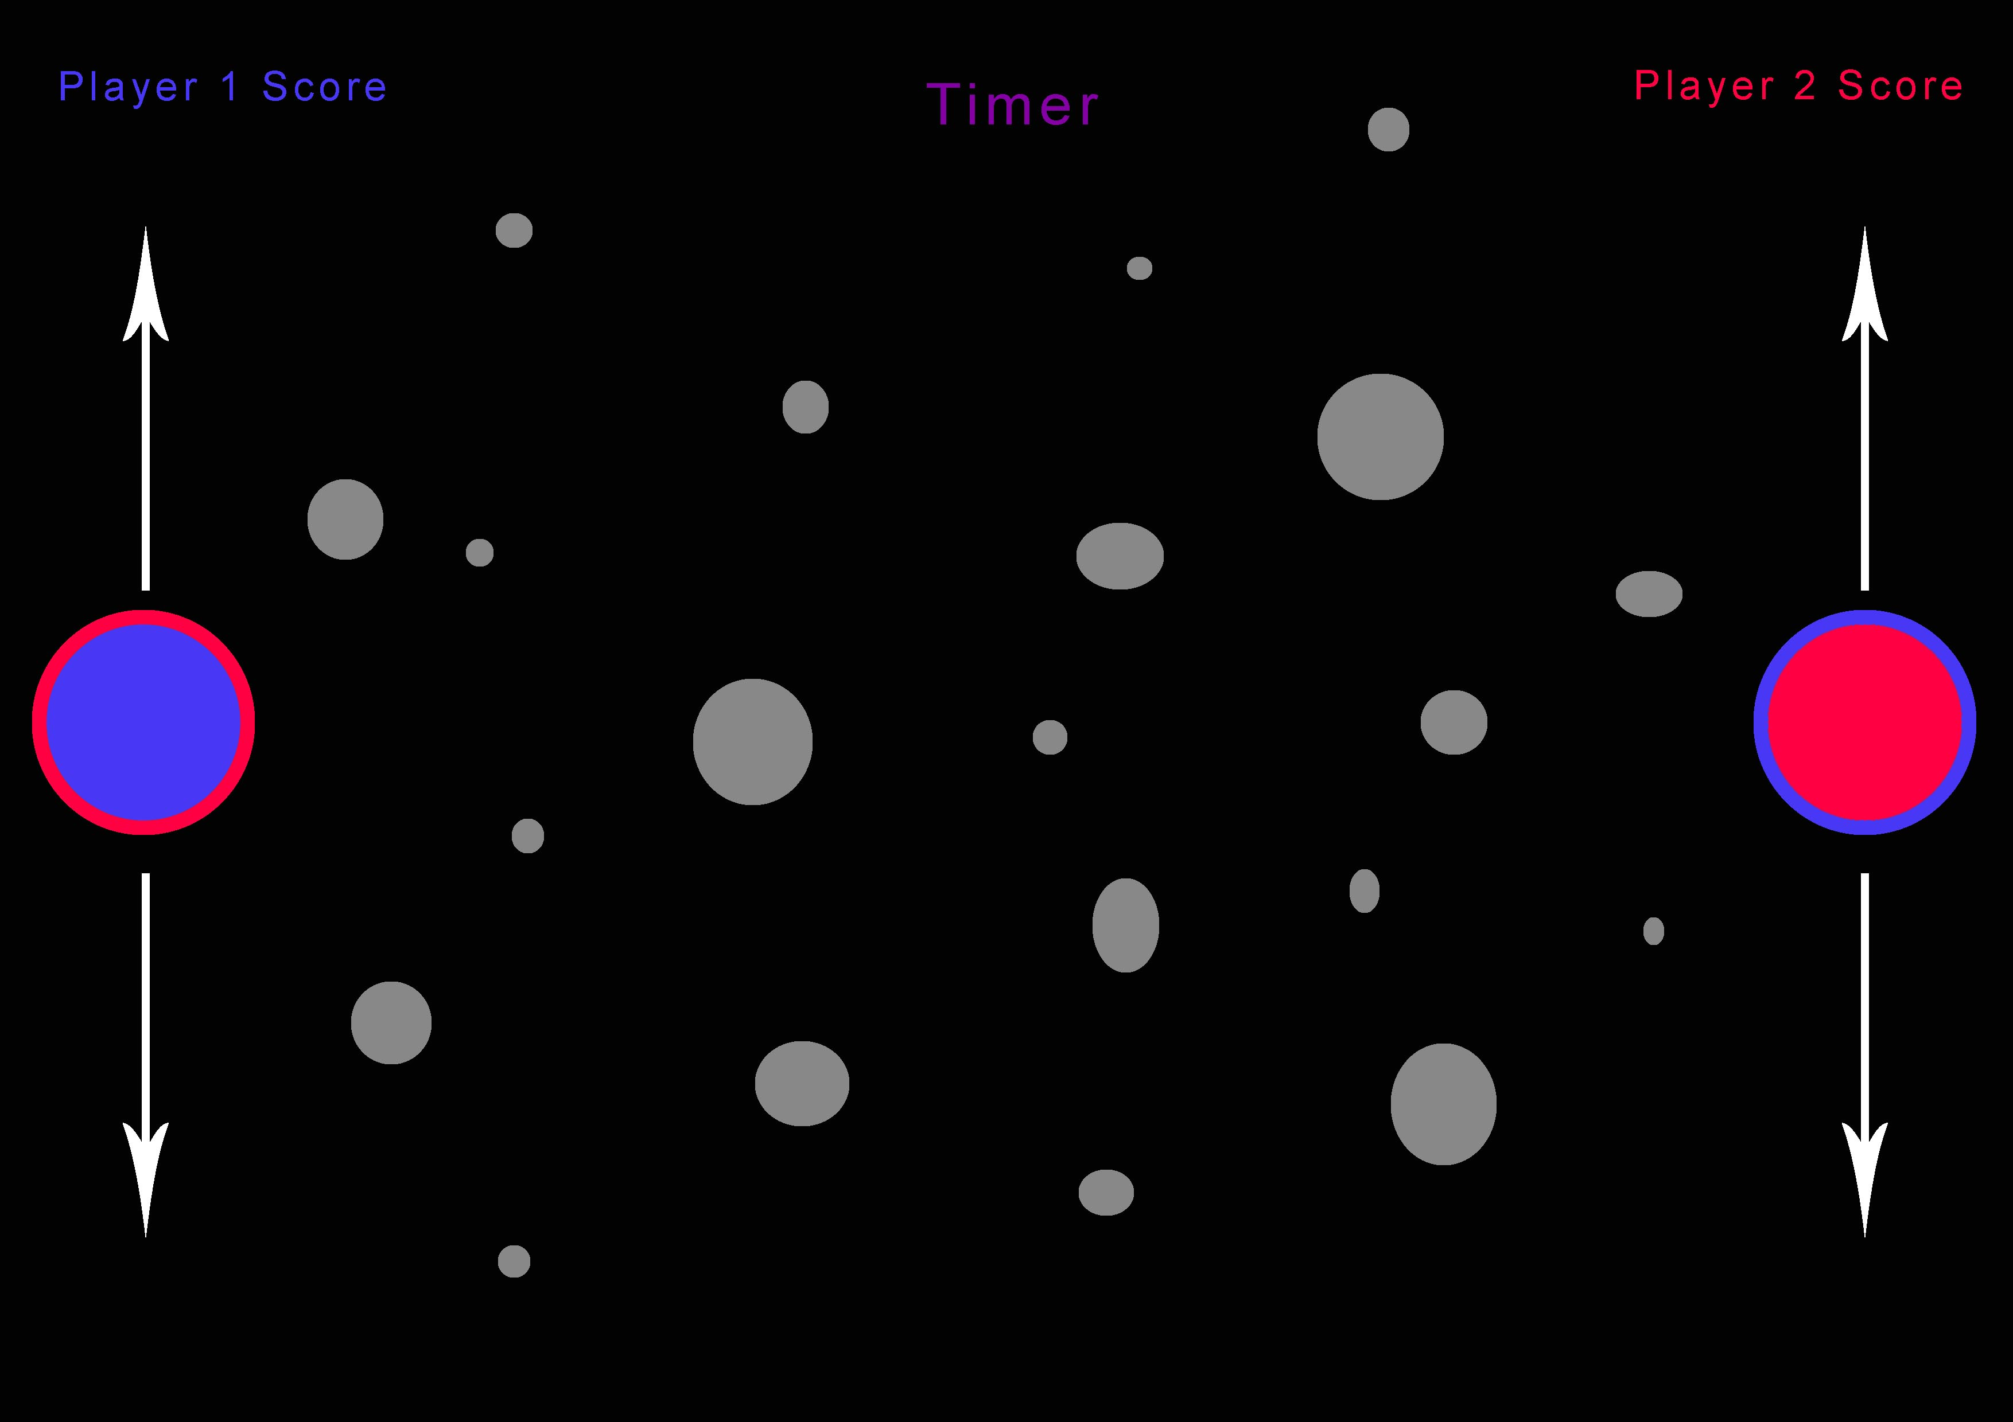
Game Concept
Easy to play.
Simple yet has complex gameplay.
Physics-based gameplay.

Slide 7
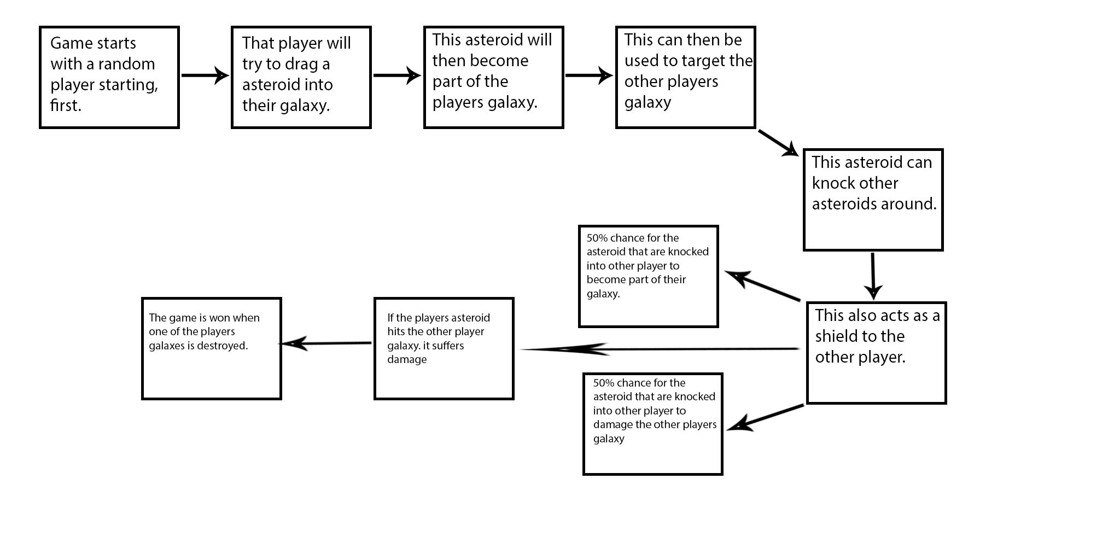
Game Concept

Slide 8
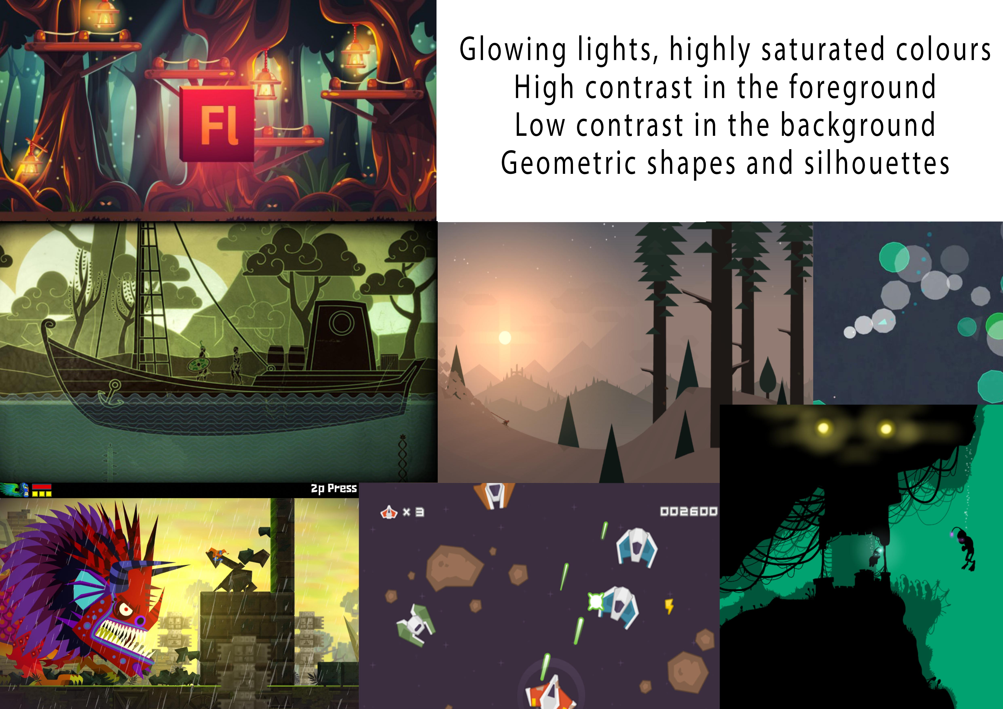



Art Style and Moodboard

Slide 9
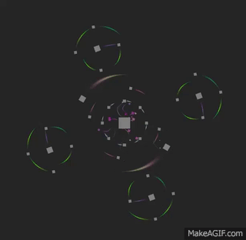
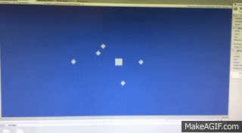
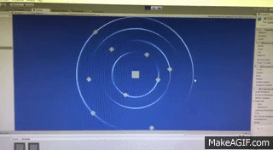
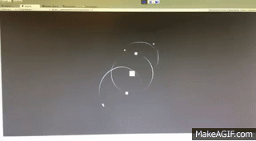
Prototypes

Slide 10
Questions?

